Slide 1

New IR Scenarios in Multimodal AI
Presented by Aleksandr Algazinov

Slide 2
About Multimodal AI
Paradigm Shift | Move beyond the traditional focus on single data types to systems that can process and integrate information from a variety of sources (modalities)
Modalities | Video, images, speech, text, sensor data (time series), etc.
Motivation | This capability allows multimodal AI to develop a more comprehensive and nuanced understanding of the environment or situation it is analyzing. By processing a richer set of information, these systems can exhibit more advanced reasoning and problem-solving capabilities, mirroring the complexity of human sensory perception
Basic Example | Multimodal model can take an image and a text description as input and generate a relevant video, showcasing its ability to process and produce information across different modalities
Applications | Human Computer Interaction (HCI), Autonomous Vehicles, Customer Service, MLLMs, etc.
Conclusion | The versatility and enhanced understanding offered by multimodal AI are driving its adoption across a wide range of industries, promising to revolutionize how we interact with technology and solve complex real-world problems

Slide 3
Why Multimodal AI in IR?
Numerous experiments show that user intent can be better captured by incorporating multiple modalities (refer to MIntRec)
Traditional IR systems, relying on text, are not that effective when users are seeking information that is best expressed or found in non-textual formats such as images, audio, or video
Opportunity to enhance the accuracy and relevance of search results, for example, when the user provides a text description along with an image to refine their search for a specific item
Multimodal IR facilitates cross-modal retrieval, allowing users to retrieve information in one modality using a query in another, such as finding images based on a text description or vice versa
Multimodal RAG systems further enhance information retrieval by augmenting language models with relevant context from multiple modalities, leading to more accurate and contextually rich responses
Vast amount of multimodal data available today (MIntRec, Social-IQ, CMU-MOSEI, etc.)

Slide 4
Topics We Will Cover
Paper Title | Topic | Publication Venue | Link | Key Contributions
MM-Embed: Universal Multimodal Retrieval with Multimodal LLMs | Foundational Embedding & Modeling Techniques | ICLR 2025 | https://arxiv.org/abs/2411.02571 | Introduces techniques for universal multimodal retrieval using MLLMs, achieves SOTA on M-BEIR, addresses modality bias
Wiki-LLaVA: Hierarchical Retrieval-Augmented Generation for Multimodal LLMs | Retrieval Pipelines & Strategic Frameworks | CVPR Workshops 2024 | https://openaccess.thecvf.com/content/CVPR2024W/MMFM/papers/Caffagni_Wiki-LLaVA_Hierarchical_Retrieval-Augmented_Generation_for_Multimodal_LLMs_CVPRW_2024_paper.pdf | Proposes a hierarchical RAG framework for MLLMs using Wikipedia as an external knowledge source, improving performance on knowledge-based VQA.
ConCon-Chi: Concept-Context Chimera Benchmark for Personalized Vision-Language Tasks | Benchmarks & Evaluation Protocols | CVPR 2024 | https://openaccess.thecvf.com/content/CVPR2024/papers/Rosasco_ConCon-Chi_Concept-Context_Chimera_Benchmark_for_Personalized_Vision-Language_Tasks_CVPR_2024_paper.pdf | Introduces a new benchmark dataset for evaluating personalized vision-language tasks, focusing on learning new meanings and compositionality with contexts.

Slide 5

1
Foundational Embedding & Modeling Techniques

Slide 6
Paper 1: MM-Embed: Universal Multimodal Retrieval with Multimodal LLMs
Problem:
Contemporary state-of-the-art retrieval models often operate within limited search scenarios, typically focusing on fixed tasks such as question answering and supporting only a single modality for both the user's query and the information being retrieved
While fine-tuning multimodal large language models (MLLMs) as retrievers has shown promise in understanding complex queries that combine modalities like text and image, these models often exhibit a modality bias, leading to underperformance compared to smaller, specialized models like CLIP, particularly in cross-modal retrieval tasks
Motivation:
Advance the field of information retrieval by exploring and developing techniques that harness the potential of multimodal large language models (MLLMs) to enable a broader search paradigm known as universal multimodal retrieval
Develop a truly universal retriever that can perform effectively and equitably across different modalities and retrieval tasks

Slide 7
Paper Contributions
Authors present a study on applying MLLMs to universal multimodal retrieval
Authors are the first to develop MLLM-based universal multimodal retrievers. Notably, their MM-Embed, initialized from the existing best-performing text retriever (NV-Embedv1), not only achieves SOTA results in the universal multimodal retrieval benchmark M-BEIR, but also surpasses NV-Embed-v1 in text-to-text retrieval tasks on MTEB
Authors explore prompting MLLMs as zero-shot rerankers in various multimodal retrieval tasks. They find that zero-shot MLLM-based rerankers can improve ranking accuracy over strong retrievers in challenging tasks involving interleaved text-image queries

Slide 8
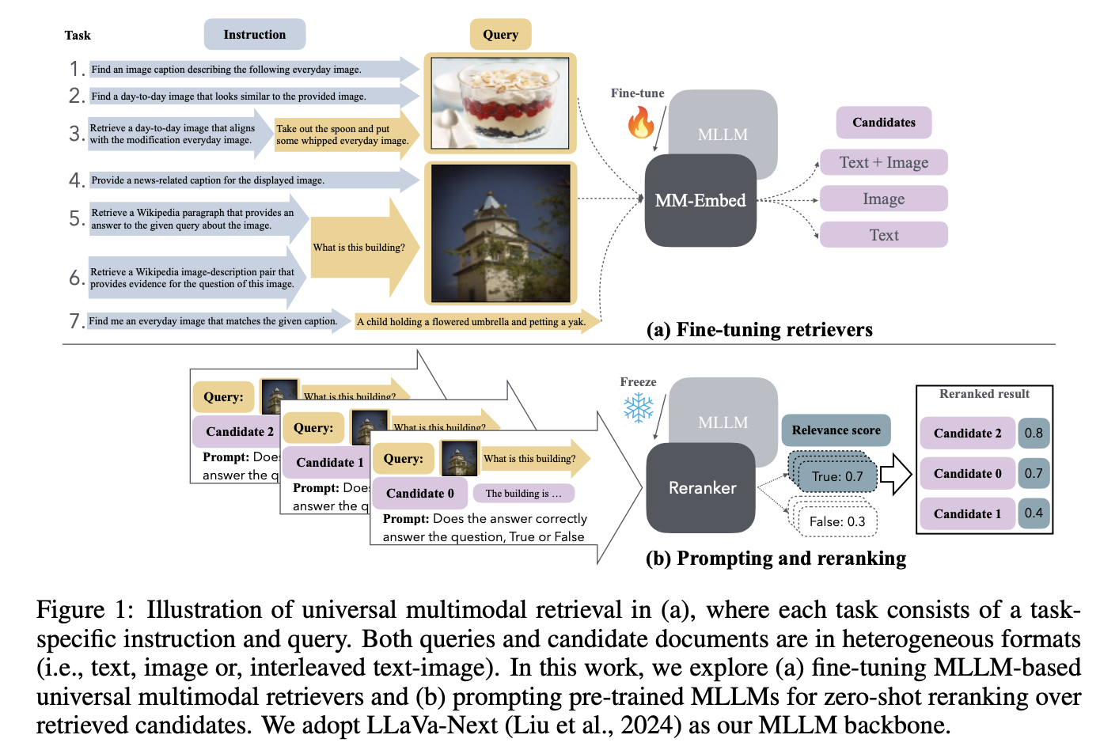
Universal multimodal retriever

Slide 9
Methodology
Authors fine-tune a pre-trained MLLM, specifically LLaVa-Next and Mistral 7B, to serve as a bi-encoder retriever. This fine-tuning process is conducted on a comprehensive set of 10 datasets from the M-BEIR benchmark, which collectively encompass 16 different multimodal retrieval tasks
To tackle the issue of modality bias, the authors introduce a novel technique called modality-aware hard negative mining. This strategy focuses on the selection of challenging negative examples during the training process. These negative samples are chosen to be relevant to the query in terms of their information need but belong to a different modality than the desired retrieved result. By training the model to distinguish between these modality-aware hard negatives and the correct positive examples, the authors aim to encourage the model to treat different modalities more equitably and reduce the inherent bias towards certain modalities
In addition to addressing modality bias, the researchers also focus on enhancing the text retrieval capabilities of their universal multimodal retriever while preserving its performance on multimodal retrieval tasks. To achieve this, they employ a strategy of continual fine-tuning. After the initial multimodal fine-tuning phase, the model is further trained on text-to-text retrieval datasets from the MTEB (Massive Text Embedding Benchmark). The NV-Embed-v1 model serves as the text embedding LLM in this process

Slide 10
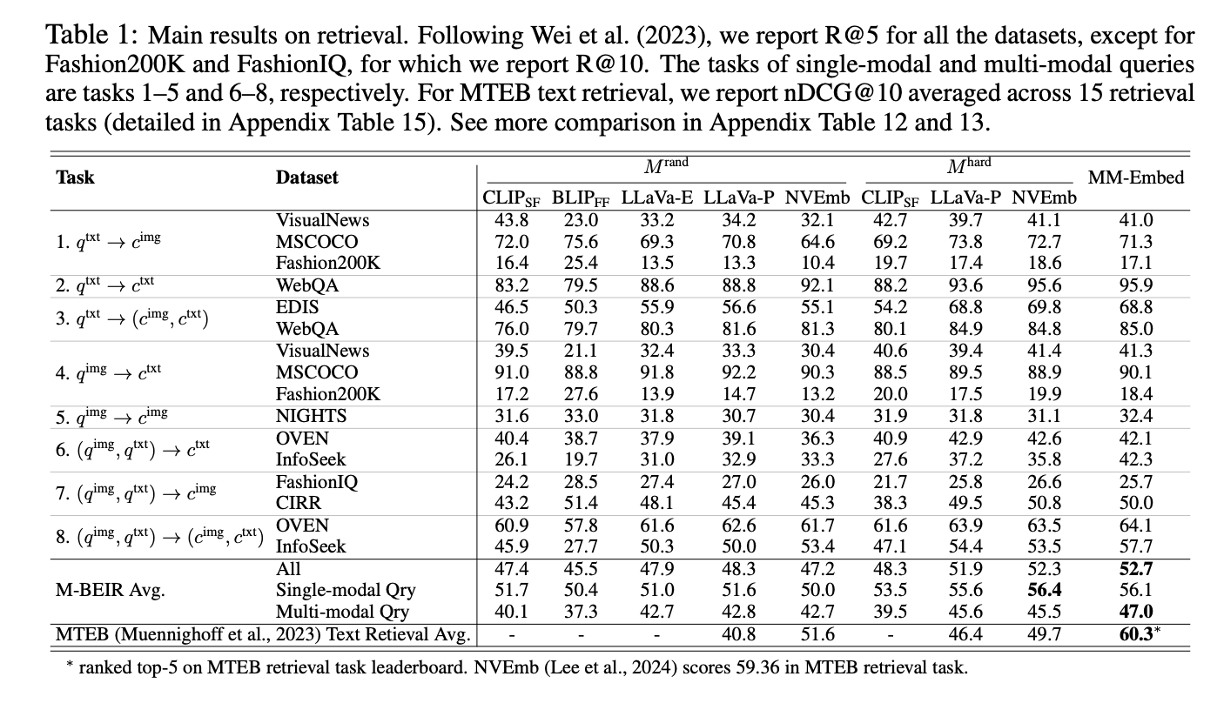
Results

Slide 11
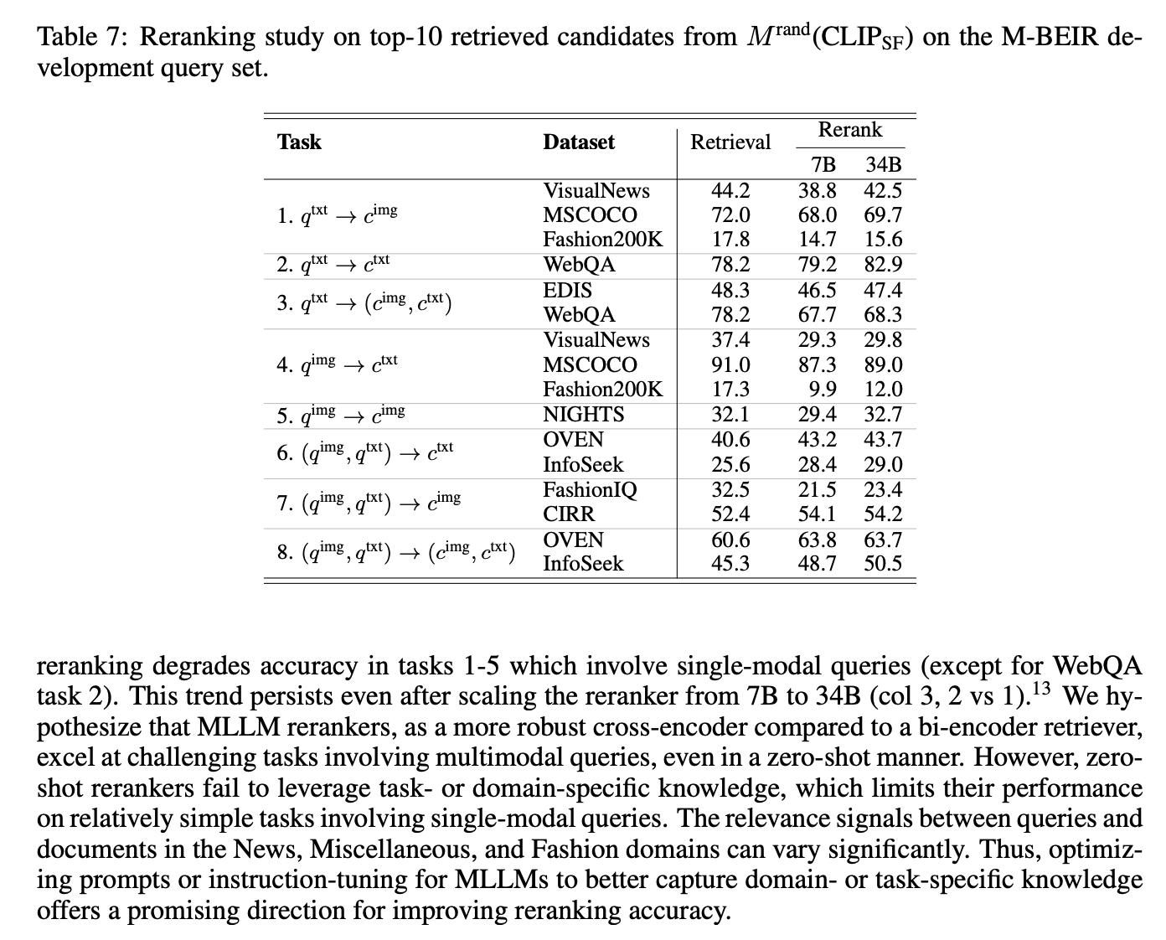
Effectiveness of Reranking

Slide 12
Conclusion and Future Work
Conclusion:
MM-Embed Achieves SOTA Performance: By fine-tuning MLLMs with modality-aware hard negative mining and continuous fine-tuning, MM-Embed surpasses previous benchmarks in universal multimodal retrieval tasks, notably on M-BEIR and MTEB datasets
Mitigating Modality Bias: The study identifies modality bias in MLLM-based retrievers, particularly in cross-modal retrieval tasks. Implementing modality-aware hard negative mining effectively addresses this issue, enhancing retrieval accuracy by 5 points on the M-BEIR dataset
Zero-Shot Reranking Enhances Retrieval: Employing MLLMs as zero-shot rerankers further boosts retrieval accuracy, especially in complex tasks like visual question answering and composed image retrieval, with improvements over SOTA retrievers by over 7 points in CIRCO
Future Work:
Distillation into Smaller Models: Plan to distill MM-Embed into more efficient multimodal retrievers like CLIP or BLIP to improve retrieval efficiency without compromising performance
Enhancing Retriever Capabilities: Explore distilling MLLM-based rerankers into retrievers to bolster retrieval capabilities in tasks involving multimodal queries
Investigating Advanced Retrieval Techniques: Consider exploring iterative retrieval with relevance feedback and generative retrieval methods to further advance universal multimodal retrieval tasks

Slide 13

2
Retrieval Pipelines & Strategic Frameworks

Slide 14
Paper 2: Wiki-LLaVA: Hierarchical Retrieval-Augmented Generation for Multimodal LLMs
Problem:
MLLMs, despite their impressive capabilities in various vision-and-language tasks, often exhibit limitations when confronted with highly specific user queries or scenarios that demand a significant degree of compositional reasoning
While benchmarks like InfoSeek and Encyclopedic-VQA have been developed to evaluate MLLMs on questions requiring external knowledge, the paper notes that prior research has not focused on developing specific architectural designs that enable these models to effectively leverage such external knowledge sources
Motivation:
Empower MLLMs with the capability to accurately and comprehensively answer complex and specific questions that cannot be adequately addressed by relying solely on the information present in the knowledge acquired during pre-training
Teach the model to effectively utilize this diverse external information in formulating its responses and to learn to perceive the relative importance of different pieces of retrieved knowledge

Slide 15
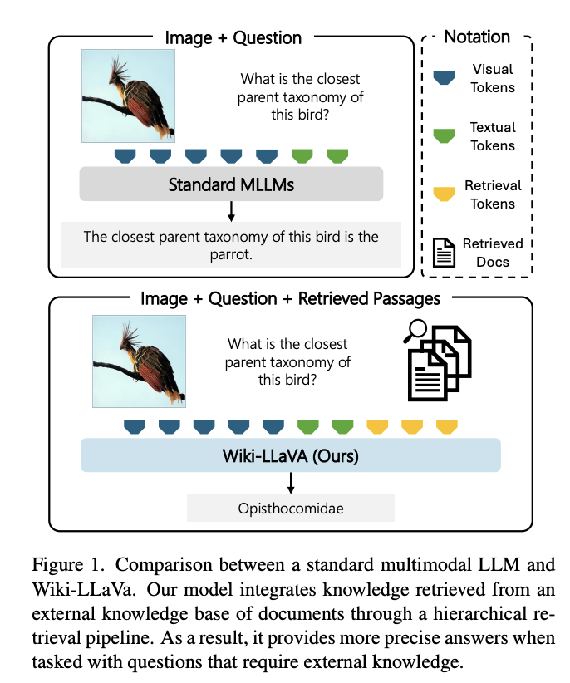
Standard MLLM vs Wiki-LLaVa

Slide 16
Methodology
Wiki-LLaVA is an architecture that builds upon the existing LLaVA model by integrating an external knowledge source (Wikipedia) through a hierarchical retrieval pipeline. The base LLaVA model consists of a pre-trained LLM (Vicuna) and a pre-trained visual model (CLIP), connected by a an MLP adapter
The core of Wiki-LLaVA lies in its two-stage hierarchical retrieval process:
Document Retrieval (First Stage): Given an input query image, the system performs an approximate k-nearest neighbor search to retrieve relevant documents from Wikipedia. The retrieval is based on the similarity between the CLIP embeddings of the input image and the text titles of the Wikipedia pages
Passage Retrieval (Second Stage): For each of the top-k documents retrieved in the first stage, the system then identifies the most relevant passages that correspond to the user's question. This is achieved by using the Contriever architecture to embed both the text chunks within the retrieved documents and the user's question. The similarity between these embeddings is then calculated to select the top-n most appropriate passages
The raw text content of the passages retrieved through this hierarchical process is then used as additional input to the LLaVA model. This retrieved knowledge serves to enrich the context available to the MLLM, thereby improving its ability to generate accurate and informative responses without requiring any significant modifications to the underlying architecture of the LLaVA model itself
In addition to this zero-shot approach, the authors also explored the possibility of fine-tuning the Wiki-LLaVA model. This fine-tuning was performed on pairs of questions and ground-truth answers that specifically require external knowledge

Slide 17
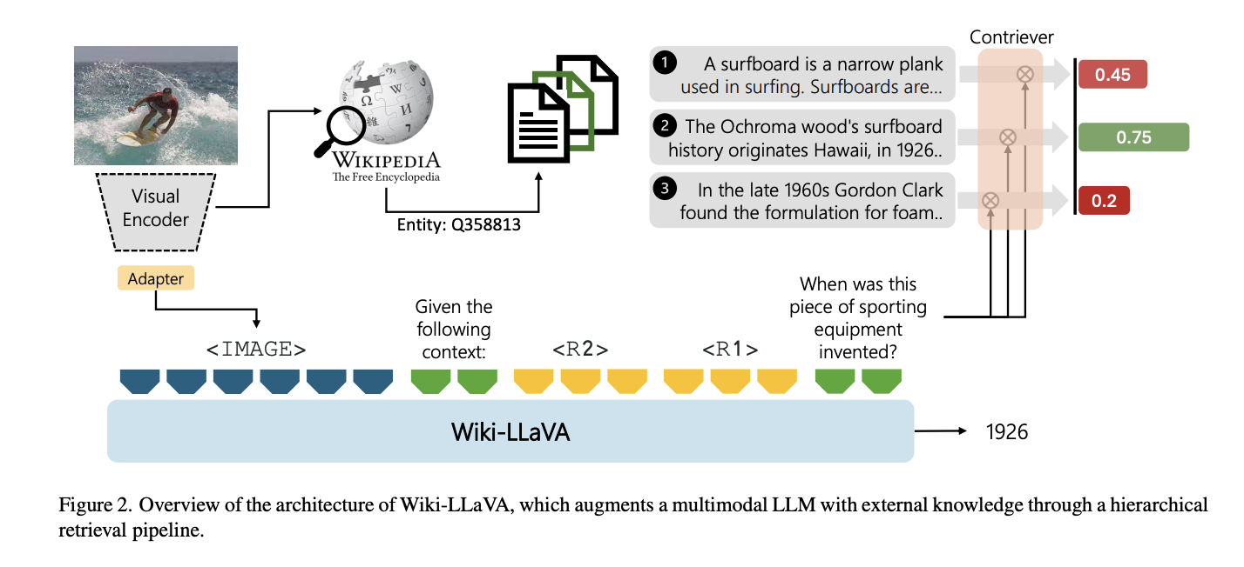
Architecture

Slide 18
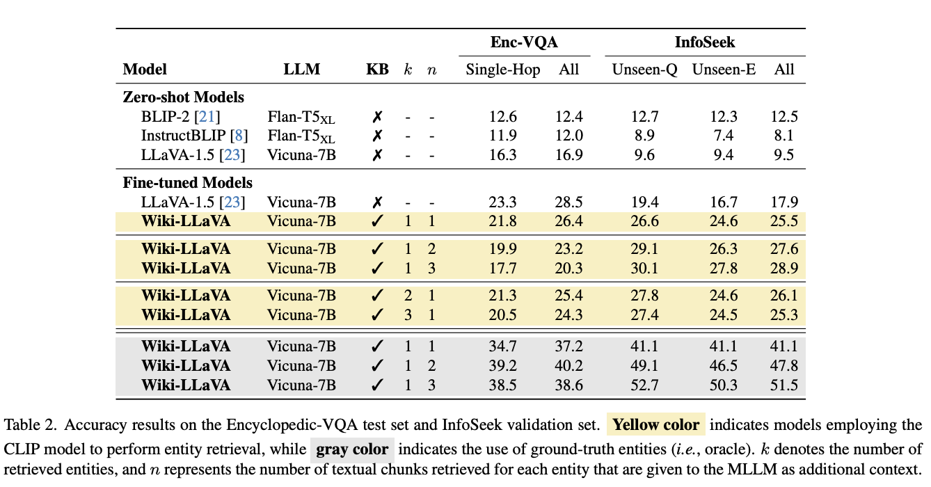
Results (Accuracy)

Slide 19
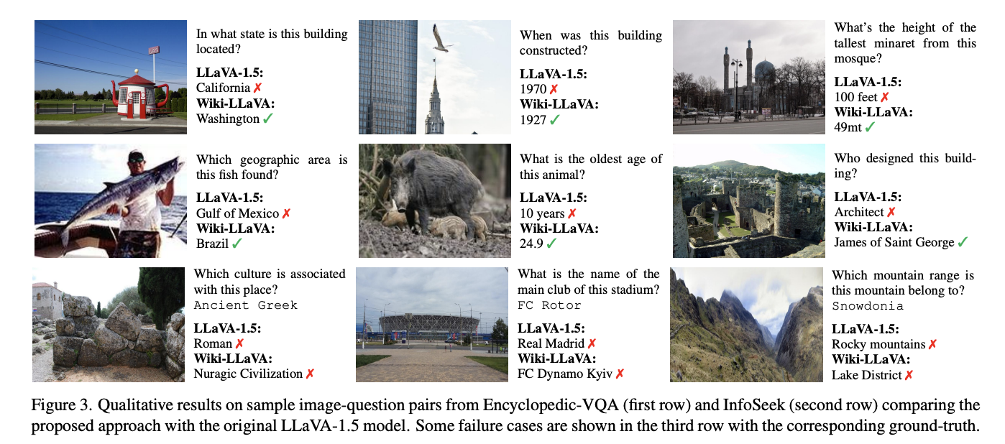
Results (Visualization)

Slide 20
Conclusion and Future Work
Conclusion:
Enhanced MLLM Capabilities: Introduced Wiki-LLaVA, the first MLLM augmented with a hierarchical retrieval module, enabling the integration of external knowledge into multimodal question answering
Improved Answer Precision: Demonstrated that incorporating retrieved external information allows the model to provide more accurate and contextually relevant responses, especially for queries requiring specific knowledge
Architecture Flexibility: Achieved these enhancements without altering the underlying MLLM structure, showcasing the adaptability and scalability of the retrieval-augmented approach
Future Work:
Expanding Knowledge Sources: Plan to incorporate a broader range of external knowledge bases, including domain-specific and multilingual datasets, to further enhance the model's versatility
Advanced Retrieval Techniques: Explore more sophisticated retrieval methods, such as semantic search and context-aware ranking, to improve the relevance and quality of the retrieved information
Real-World Applications: Aim to apply Wiki-LLaVA in practical scenarios like education, healthcare, and customer support, assessing its performance and utility in real-world tasks

Slide 21

Benchmarks & Evaluation Protocols
3

Slide 22
Paper 3: ConCon-Chi: Concept-Context Chimera Benchmark for Personalized Vision-Language Tasks
Problem:
While recent Vision-Language Models (VLMs) have shown remarkable progress in open-vocabulary tasks, their effectiveness with dealing with specific or uncommon concepts, particularly in personalized settings, remains unexplored
Existing benchmark datasets for personalized concept learning often fall short in adequately evaluating two critical properties: the ability of models to learn truly new meanings and their capacity to compose these newly learned meanings with known contexts
Motivation:
Create a benchmark that specifically assesses the models' ability to learn genuinely novel concepts and to understand how these concepts can be composed with a diverse range of known contextual information
Create a new dataset that allows for a more thorough evaluation of personalized VLMs

Slide 23
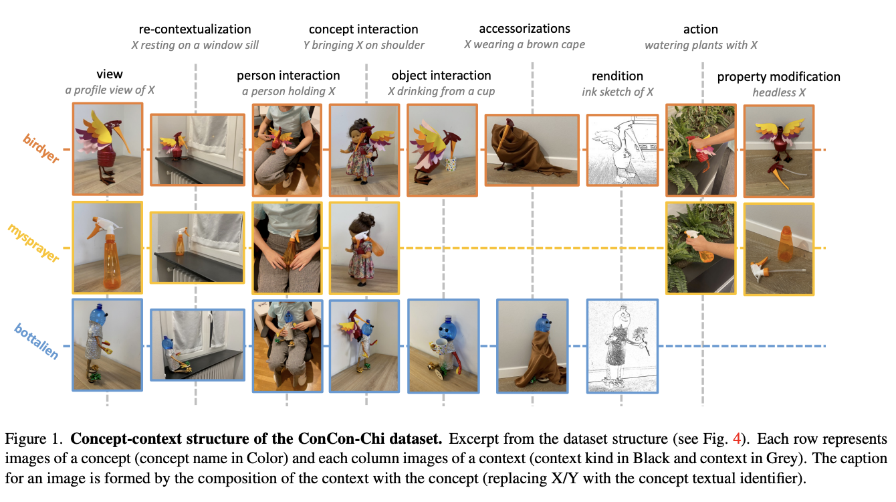
Dataset Structure

Slide 24
Methodology
The ConCon-Chi dataset includes a total of 20 concepts, 6 of which are novel "chimeric" concepts and 14 are common concepts. These concepts were then photographed in a diverse set of 101 contexts, which were further categorized into 9 different kinds. The chimeric concepts were specifically designed by physically crafting objects that combined features of two unrelated existing concepts, such as a snake + an alien
A key aspect of the ConCon-Chi dataset is its structure as a concept-context matrix. This design ensures that multiple concepts appear within the same context, and conversely, each concept is photographed across a wide variety of contexts. This structure is intended to promote the assessment of the models' ability to understand the compositionality of concepts and contexts and to mitigate potential biases that might arise if concepts and contexts were uniquely paired
The paper establishes ConCon-Chi as a benchmark for two personalized VL tasks: Text-to-Image Retrieval (TIR) and Text-to-Image Generation (TIG). For the TIR task, the ability of models to learn a concept from a small number of example images and then retrieve images of that concept in various contexts based on textual queries is evaluated. For the TIG task, the benchmark assesses the models' capacity to generate images of a learned concept in different contexts given textual prompts
To establish baseline performance, the researchers evaluated several state-of-the-art methods on both the TIR and TIG tasks. The performance of these methods was assessed using standard evaluation metrics

Slide 25
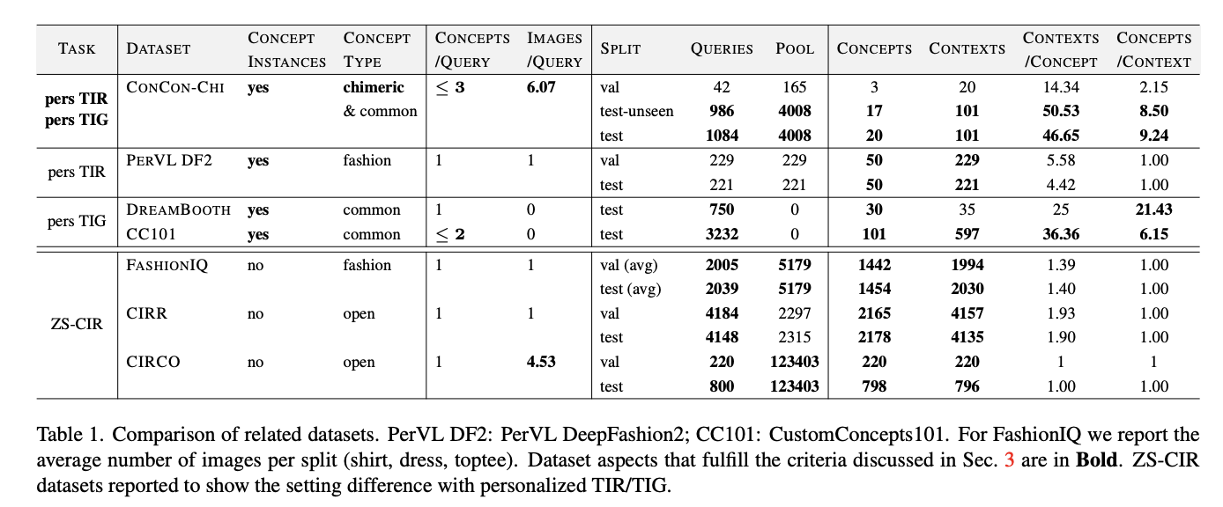
Datasets Comparison

Slide 26
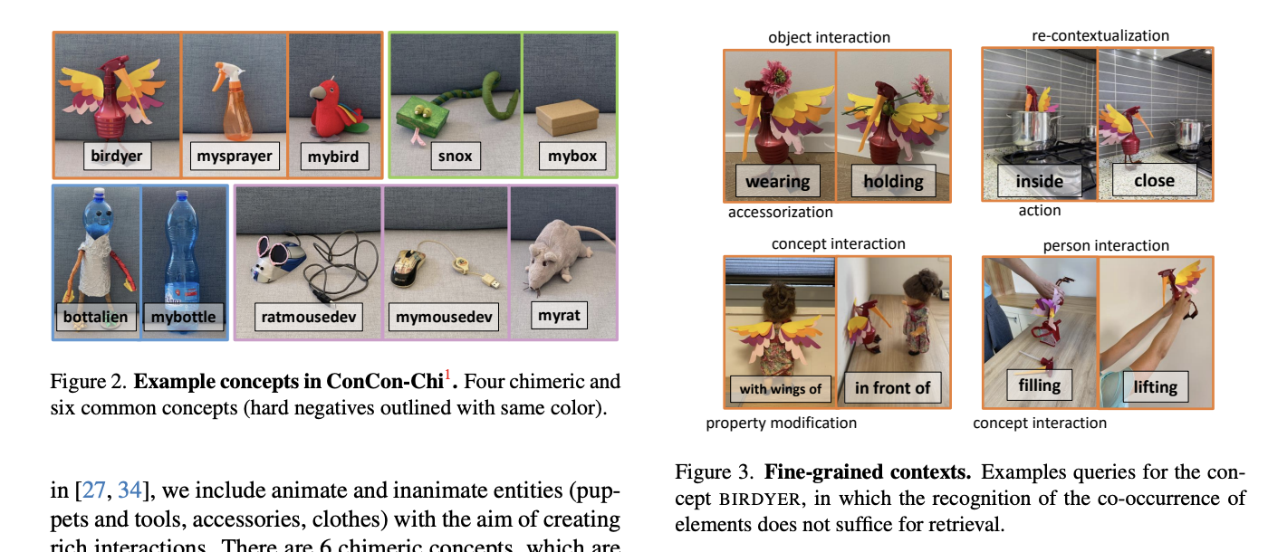
Concepts and Contexts

Slide 27
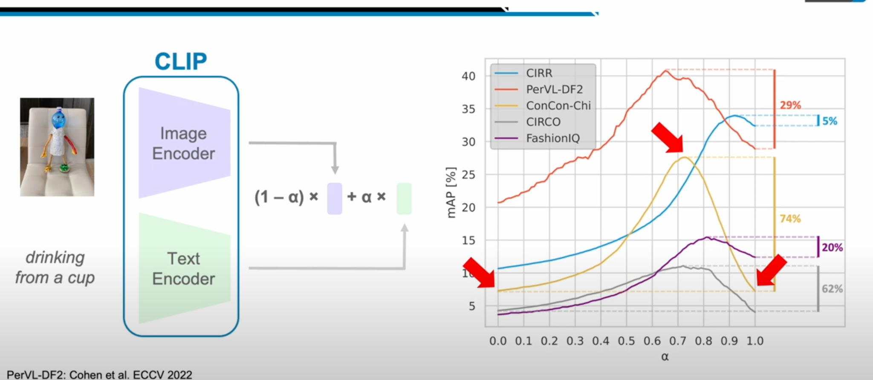
Why Both Concepts and Contexts Are Important?

Slide 28
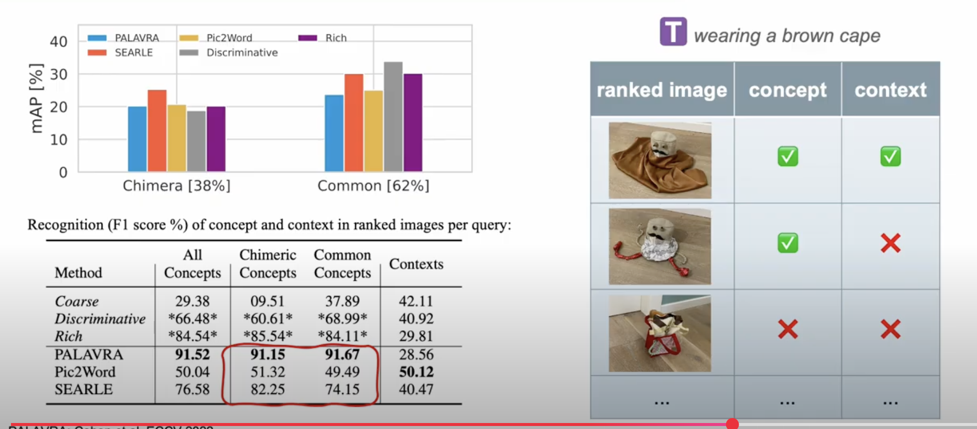
Performance of the SOTA methods

Slide 29

Conclusion
Introduction of a Novel Benchmark: The paper presents ConCon-Chi, a benchmark specifically designed to evaluate personalized VL tasks, focusing on the model's ability to learn new concepts from limited examples and apply them across diverse contexts
Emphasis on Compositional Generalization: ConCon-Chi assesses models on their capacity to combine newly learned concepts with various contexts, highlighting the importance of compositionality in personalized vision-language systems
Identification of Performance Gaps: Through evaluations using ConCon-Chi, the study reveals that current SOTA models struggle with personalized tasks, indicating a need for future research to focus on improving models' abilities to learn and generalize new concepts effectively

Slide 30

Inspirational Words
We believe that Multimodal AI models are essential for reaching AGI, since it is challenging to understand the world via single modality. Despite the recent progress, this research direction remains relatively new, and offers multiple challenges, which can and should be viewed as exciting opportunities

Slide 31

Thanks!
Do you have any questions?

